Slide 1
Comparative Analysis of Gibbs v. Metropolis-Hastings Sampling for Bayesian Inference
By Parker Walters

Slide 2
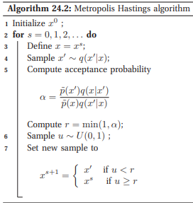
What is Metropolis-Hastings Sampling?
Proposes a new state based on proposal distribution and then either accepts or rejects it based on an acceptance ratio
Doesn’t require conditional distributions to be analytically tractable, only the target/posterior distribution which is up to a constant factor

Slide 3
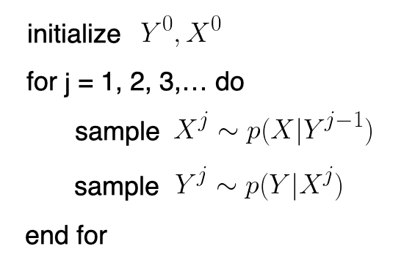
What is Gibbs Sampling?
Special case of Metropolis-Hastings where proposals are always accepted
Samples each variable sequentially from a conditional distribution, given all other variables
Relies on the assumption that the conditional distribution of the variables are analytically tractable

Slide 4
Plan for Analysis
Run a Bayesian Inference simulation example with both Gibbs and Metropolis-Hastings
Compare multiple aspects of the data from final results such as resulting distributions and multiple tests and tools to analyze the performance of the distributions
With results compare and contrast strengths and weaknesses of each sampling method

Slide 5

Simulation Plan
Likelihood: Normal Distribution w/ unknown μ
Prior: Uniform(0,10)
Posterior: x = 5, σ²=1, μ ∼ Uniform(0,10) -> N(μ;5,1) The posterior should resemble a truncated normal centered around 5
4 chains, 1000 iterations, no burn-in

Slide 6
Results Overview
Gibbs:
Mean: 4.944
SD: 1.012
Naive SE: 0.016
Time-series SE: 0.016
Metropolis-Hastings:
Mean: 5.086
SD: 1.084
Naive SE: 0.017
Time-series SE: 0.086
Mean Acceptance Rates: 0.842

Slide 7
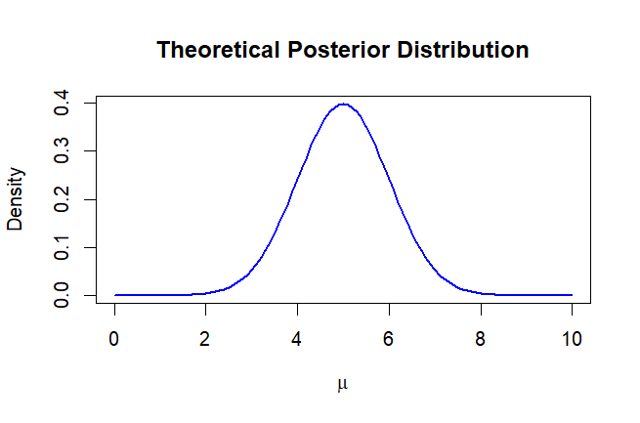

Slide 8
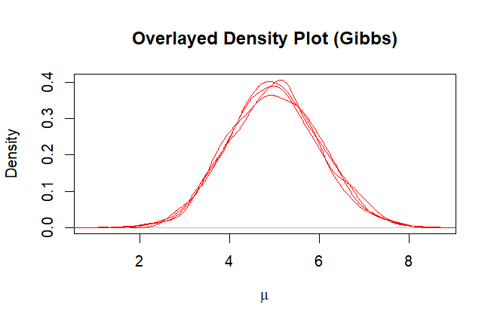
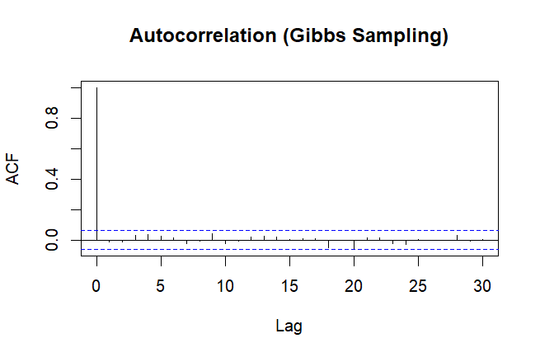
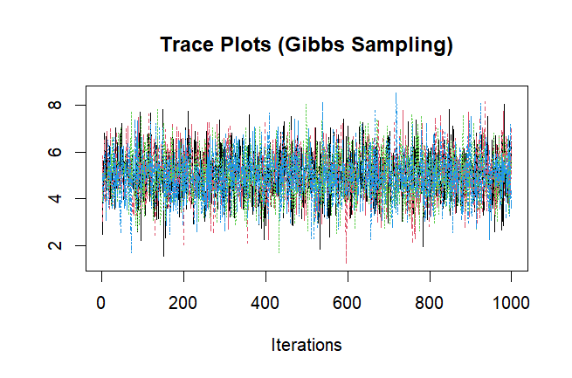
In Depth Look on Gibbs
RHAT: 1.000618
Effective Sample Size: 4000

Slide 9
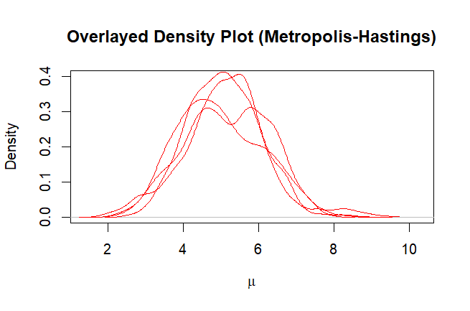
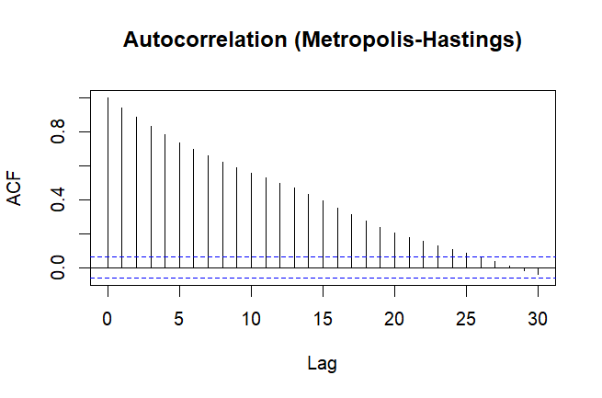
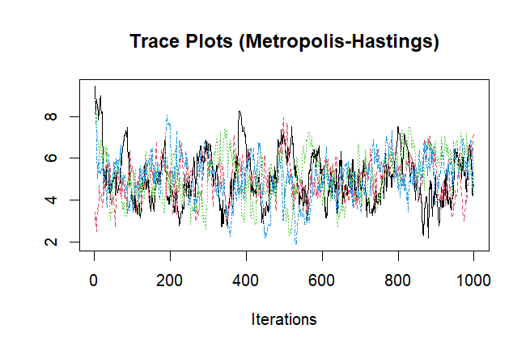
In Depth Look on Metropolis-Hastings
RHAT: 1.028659
Effective Sample Size: 175

Slide 10
Conclusion On Analysis
In this case Gibbs was better
Why not always Gibbs over Metropolis-Hastings?
MH doesn’t always require conditional distributions to be analytically tractable
Why not do another test that follows those requirements?
Gibbs is incredibly unstable under those tests, must have conditional distributions that are analytically tractable
Ex: Likelihood - x∼N(μ,σ²) where σ² is known, Prior - μ∼Cauchy(0,1)
Since Cauchy is a non-conjugate to the Normal Likelihood, the posterior can not be solved directly or conditionally because it doesn’t have a closed form solution
So ultimately, the result that were found make sense within the inherent traits and limitations of each respective sampling method
To improve Metropolis-Hastings could possibly look to start off with a better proposed distribution
For this test used a “random guestimate distribution”

Slide 11
Strength v. Weaknesses
Gibbs
Strengths:
Efficient w/ simple conditional distributions
Simple to Implement
Works well in Bayesian models where conditional distributions are known
Weaknesses:
Limited in flexibility
Can be slow to converge if variables are highly correlated
Metropolis-Hastings
Strengths:
Can handle correlated variables well if proposal distribution is well designed
Very flexible, can handle any posterior distribution if it can be handled to a constant
Weaknesses:
Requires careful tuning of proposal distribution for good performance
Can be computational intensive due to frequent rejections

Slide 12
Thank you!
Questions?

Slide 13
Short History of Computational Applications for Bayesian Inference Sampling
1980s / Rise of Markov Chain Monte Carlo
Saw the beginning of continued use of Markov Chain Monte Carlo(MCMC) with increased computational strength
Gibbs & Metropolis-Hastings Sampling grew in popularity.
1990s & Early 2000s / Implementation of Specialized Software
BUGS(Bayesian Inferences Using Gibbs Sampling)
JAGS(Just Another Gibbs Sampler)
Late 2000s Early 2010s / Hamiltonian Monte Carlo
Hamiltonian Monte Carlo began a path of a more efficient way of exploring high parameter spaces using gradient information
Stan(Based on HMC & No-U-Turn Samper(NUTS))

